Slide 1
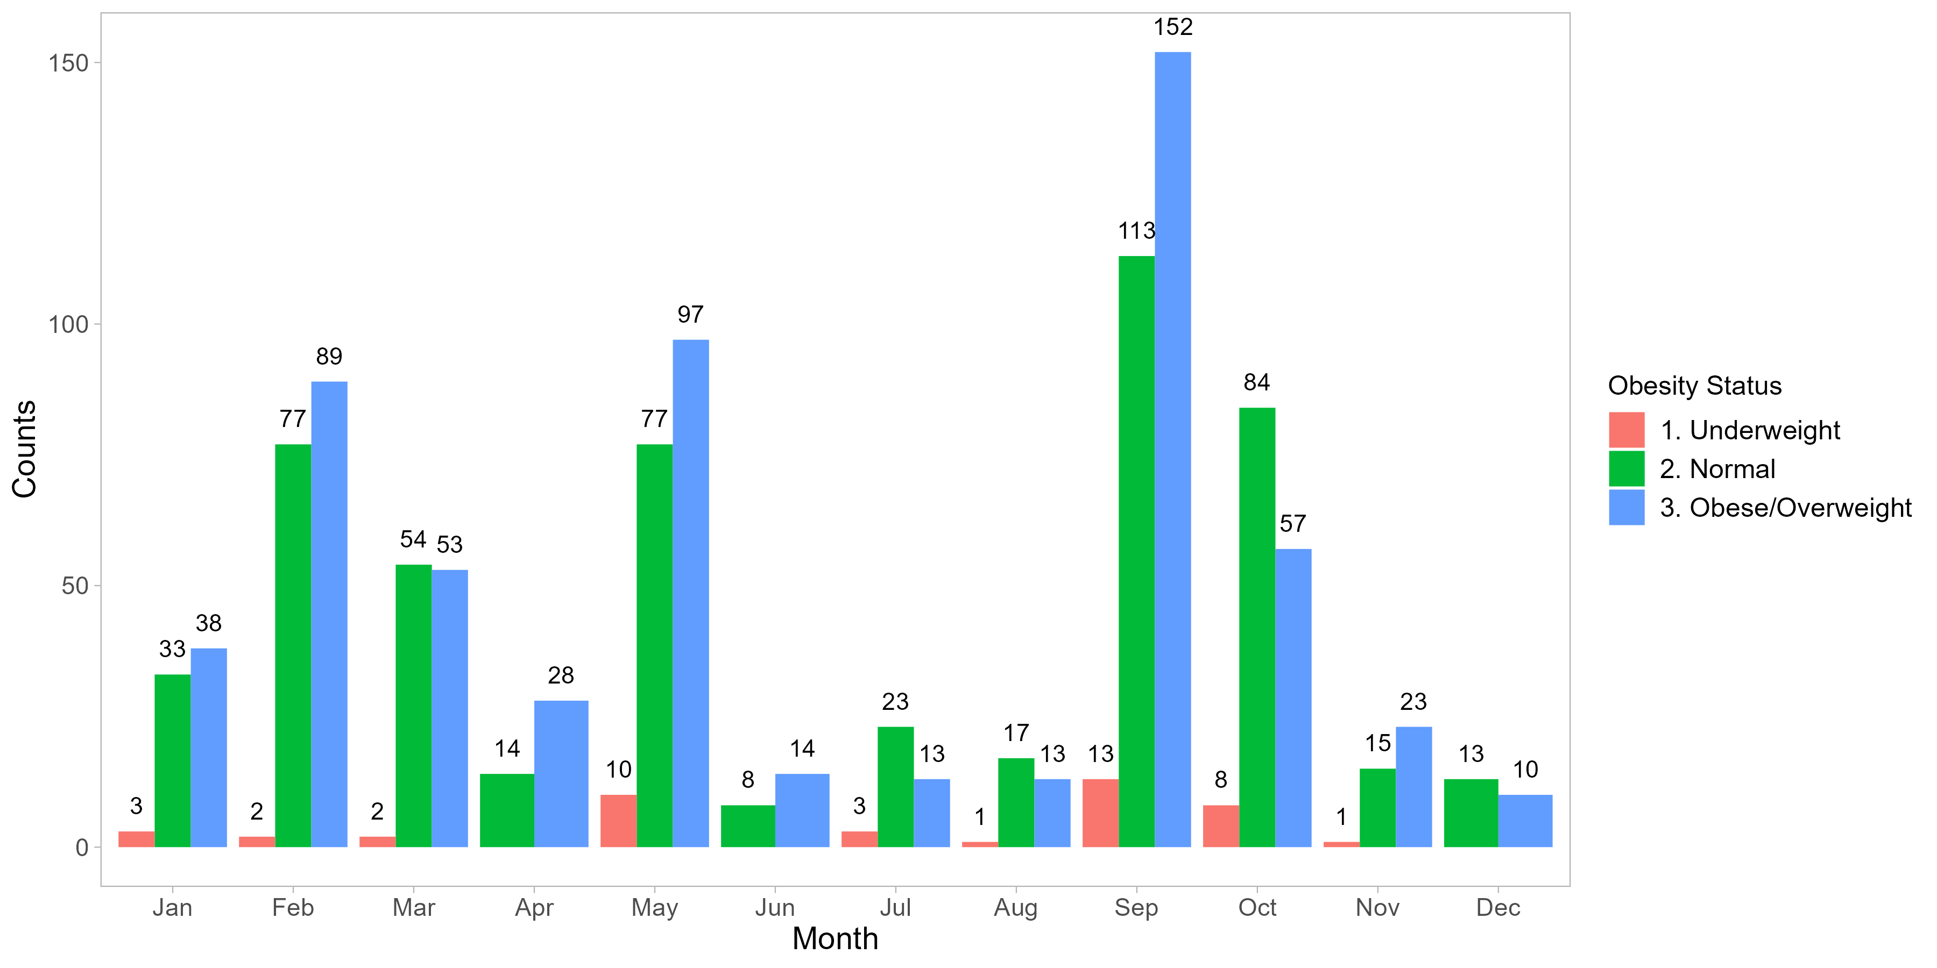
Q1 UW n = 7
NW n = 164
OB/OW n = 180
Q2
UW n = 10
NW n = 99
OB/OW n = 139
Q3
UW n = 17
NW n = 153
OB/OW n = 178
Q4
UW n = 9
NW n = 112
OB/OW n = 90

